Slide 1

Publication Challenges in Games & Interactive Media
Elizabeth Lawley, Rochester Institute of Technology
School of Interactive Games & Media
Resources at links.lawley.net/fdg2019

Slide 2
Key Questions
What types of scholarship are (or should be) valid for games & interactive media faculty?
How can (or should) our work be published and disseminated?
How do we archive and cite games and media created by faculty?

Slide 3
Who Decides the Validity of Interdisciplinary Work?
Expectations
Potential Venues
(Inter)Discipline(s)
Universities
Colleges
Departments
Committees
External Reviewers
Conferences?
Journals?
Monographs?
Non-scholarly press?
Games?
Media projects?
Notes:
How do you assess

Slide 4
Interdisciplinary Journals & Conferences
Institutional reviewers are unfamiliar with these venues
Most interdisciplinary publications/conferences are too new to have a high impact factor
Self-perpetuating problem—early career scholars are reluctant to publish in these venues, so impact factor doesn’t increase

Slide 5
Archiving and Citing Games & Interactive Media
“The map is not the territory”
Multiple components, including design documents, code, executables, presentation/performance, user experience, critical response
Primarily dependent on scholars self-archiving and providing access to materials
If you can’t cite it, you can’t show dissemination or impact!

Slide 6
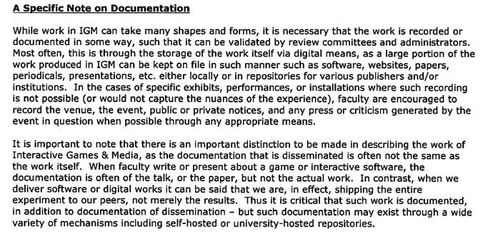
RIT/IGM Guidelines, page 5

Slide 7
Possible solutions

Slide 8
Specialized Repositories
Support complex, multi-object records
Easy for scholars to create and add content to records
Facilitates discovery and retrieval by researchers and evaluators

Slide 9
Games Repository Research
Past Projects
Preserving Virtual Worlds
GAMECIP (UCSC/Stanford)
Current Work (IMLS)
University of Utah
University of Washington
RIT has applied for an NEH grant to focus on functional design

Slide 10
Post-Publication Peer Review
Nearly everyone agrees that current peer review is deeply broken
Very difficult to replace current practices wholesale, but PPPR adds another approach to assessment

Slide 11
PPPR Approaches
Open post-publication review
Altmetrics
MediaCommons
Secondary expert review process
Restricting commentary to vetted experts
Overlay journals (aka “deconstructed journals”)

Slide 12
Overlay Journals
Interdisciplinary editorial board selects previously published articles for inclusion
Content similar to an anthology or annotated bibliography, process similar to a journal
Allows pre-tenure faculty to “double-dip” by publishing in accepted venues and in an interdisciplinary context
Provides established faculty with a regular update on important research in their field

